Slide 1
Wireframes
high fidelity
My Thai Star - Devon Example
SPRINT 2

Slide 2

Index
User area
Log in
Register
User menu
Reset password
Twitter account
Twitter
Rate dish
Email rate dish
Waiter area
Waiter orders
Waiter orders detail
Waiter reservations
Waiter reservations detail

Slide 3
User area
MY THAI STAR

Slide 4
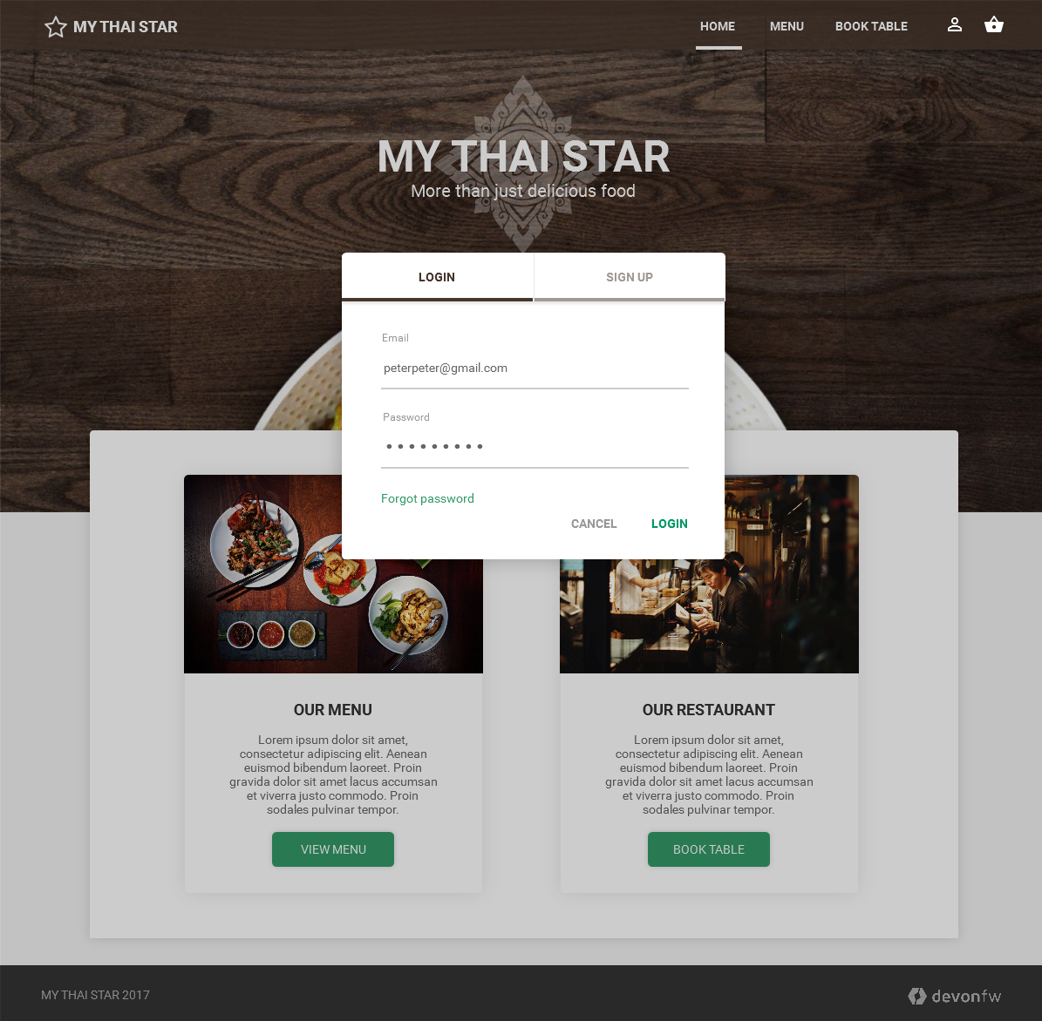
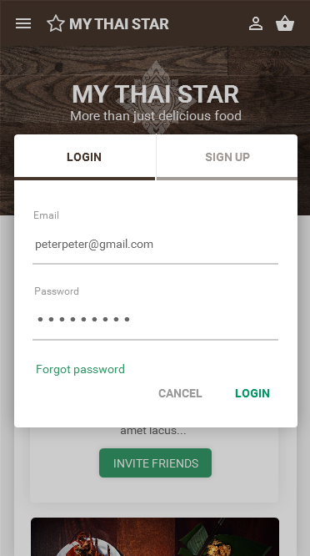
User area: log in
Desktop
Mobile

Slide 5
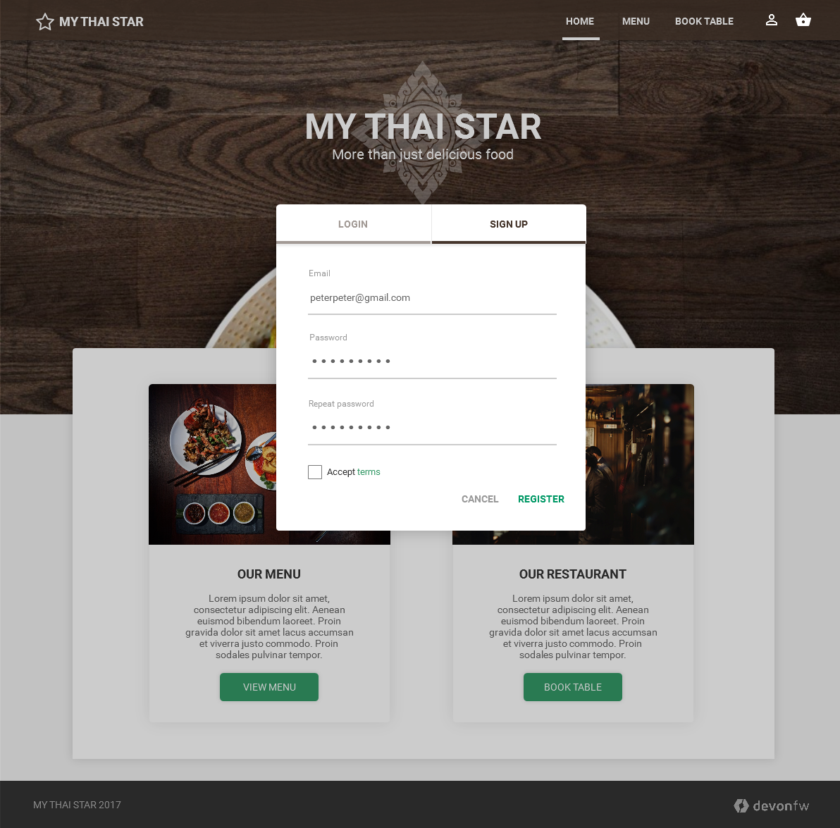
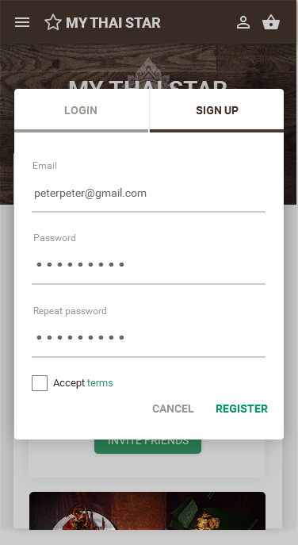
User area: register
Desktop
Mobile

Slide 6
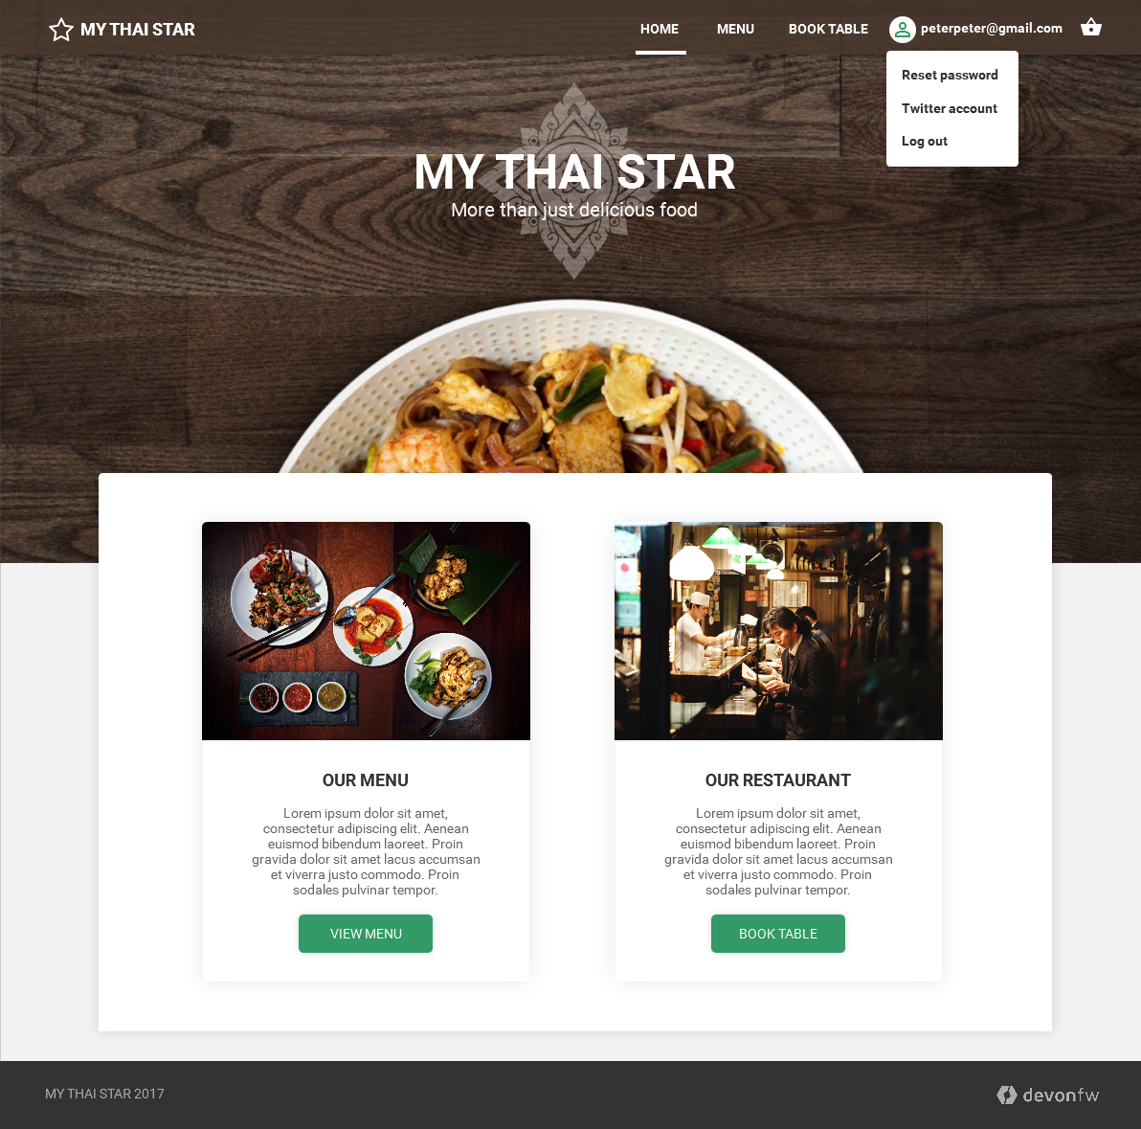
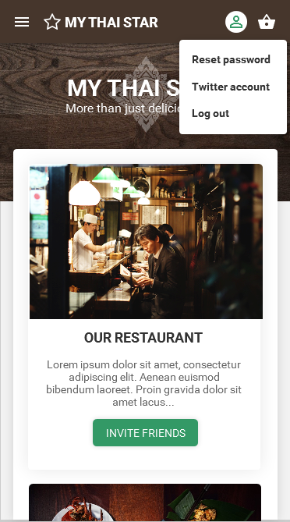
User area: user menu
Desktop
Mobile

Slide 7
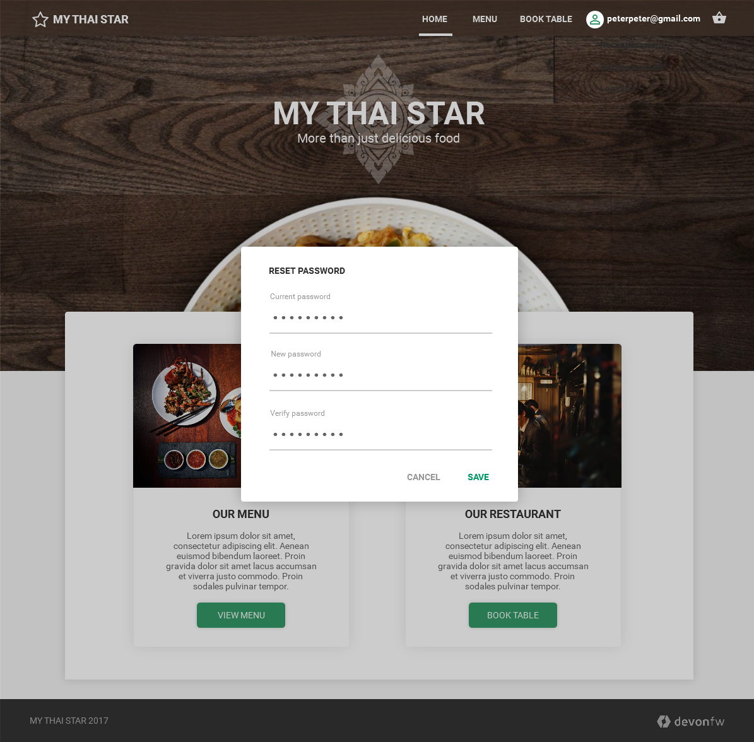
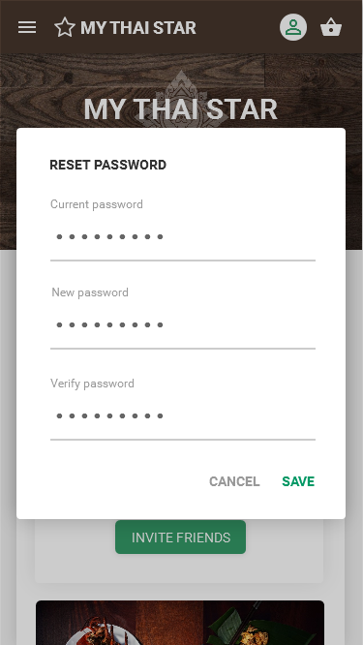
User area: reset password
Desktop
Mobile

Slide 8
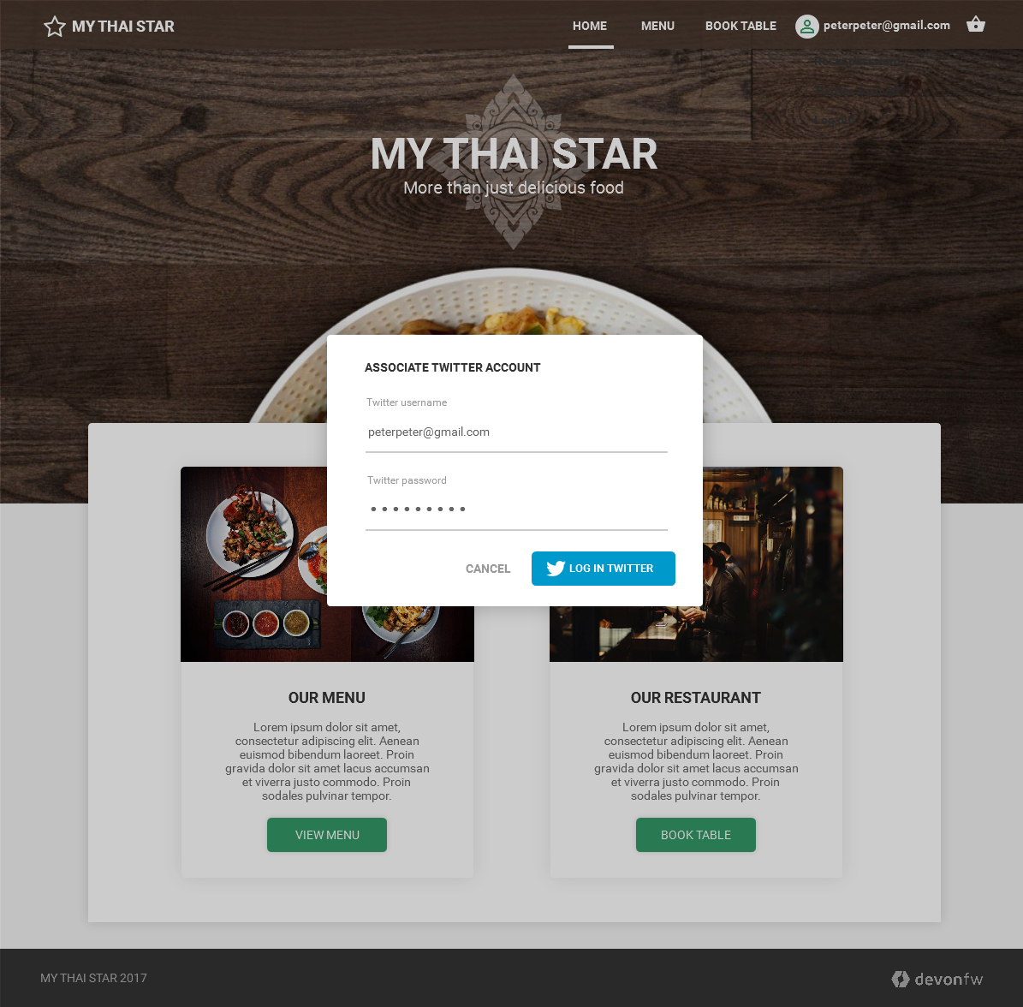
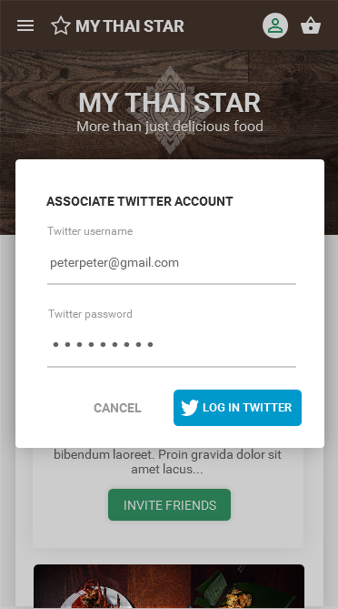
User area: Twitter account
Desktop
Mobile

Slide 9
Twitter
MY THAI STAR

Slide 10
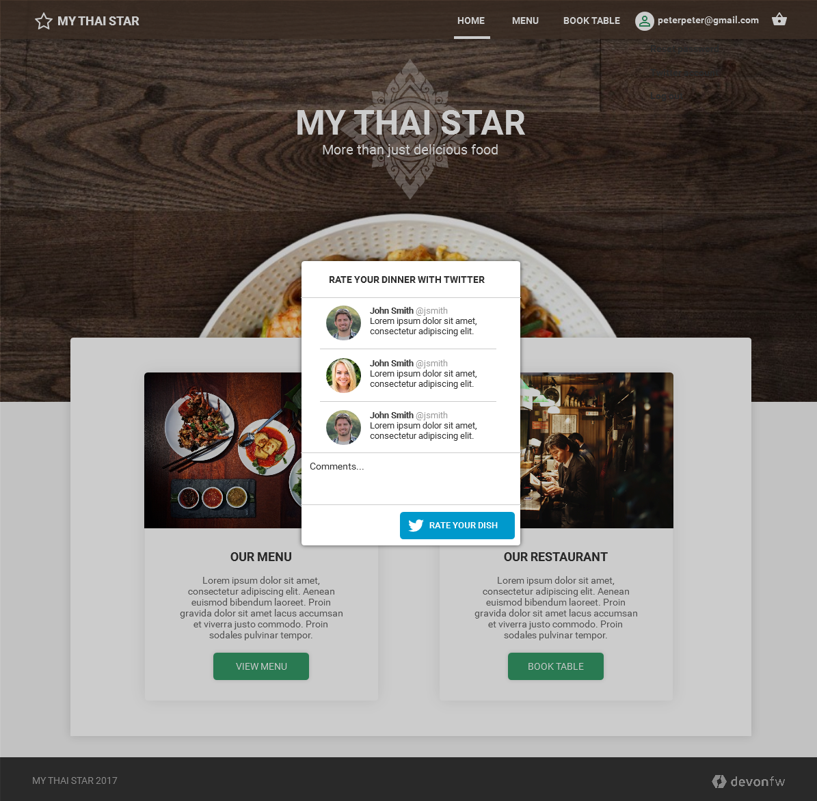
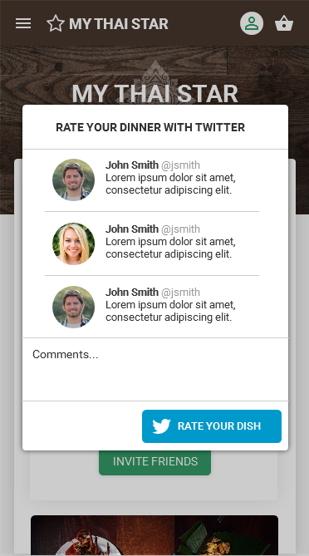
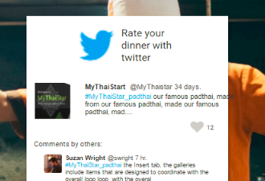
Twitter: rate Twitter
Desktop
Mobile

Slide 11
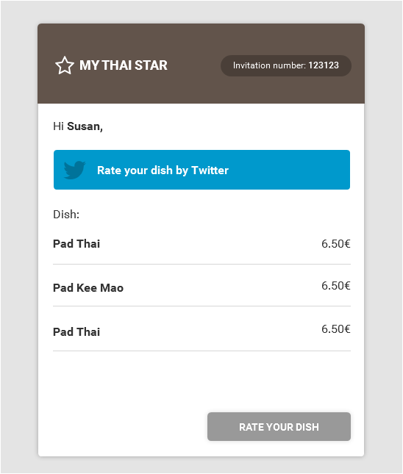
Twitter: email rate Twitter

Slide 12
Waiter area
MY THAI STAR

Slide 13
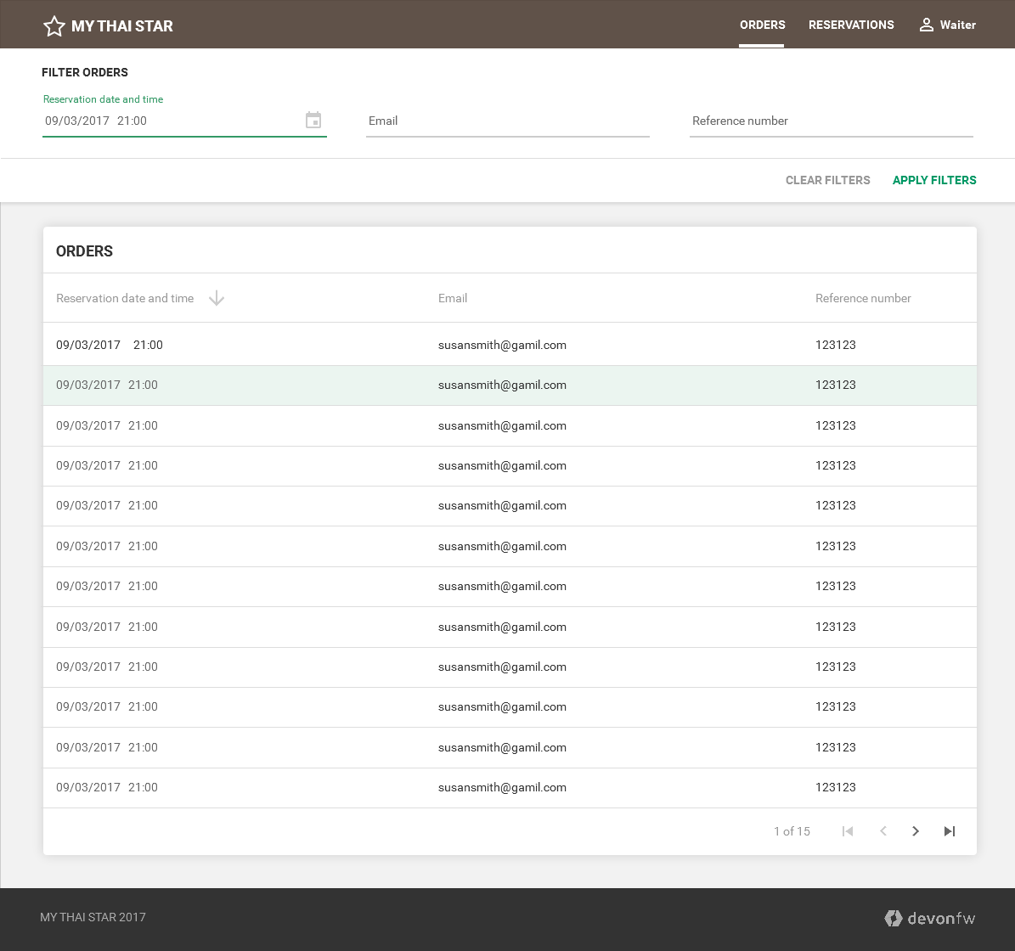
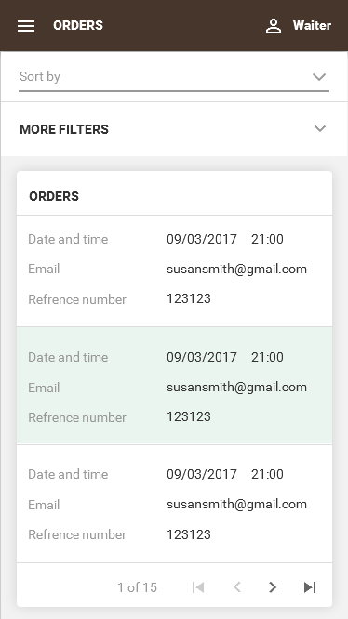
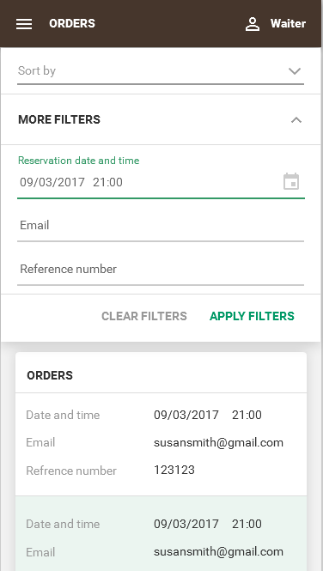
Waiter area: orders
Desktop
Mobile

Slide 14
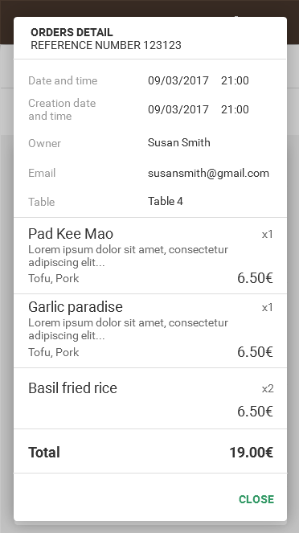
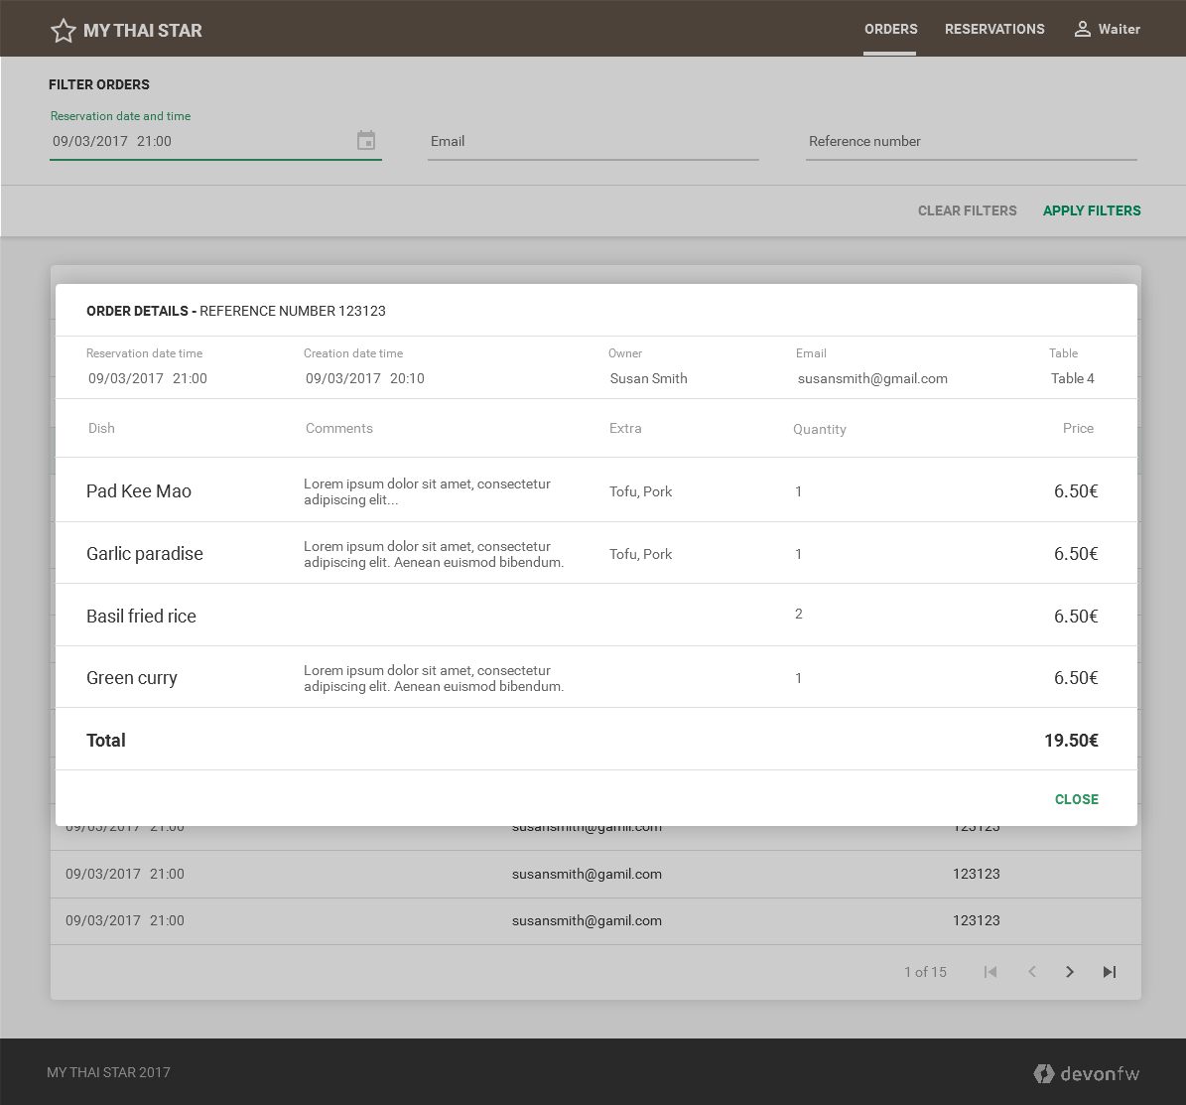
Waiter area: orders detail
Desktop
Mobile

Slide 15
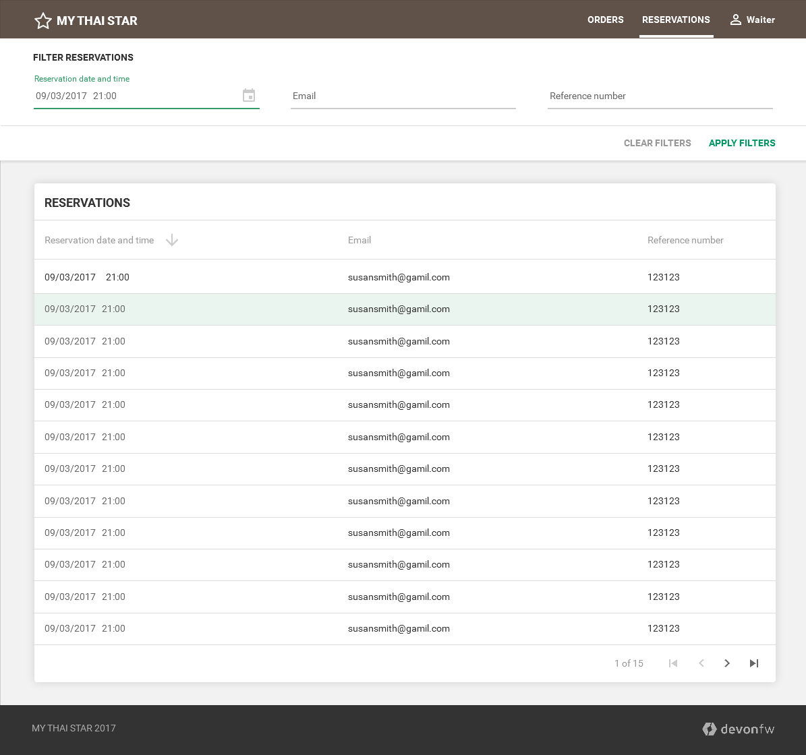
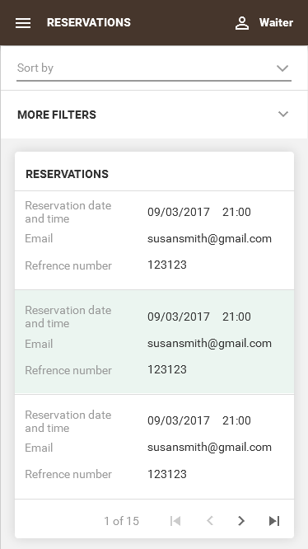
Waiter area: reservations
Desktop
Mobile

Slide 16
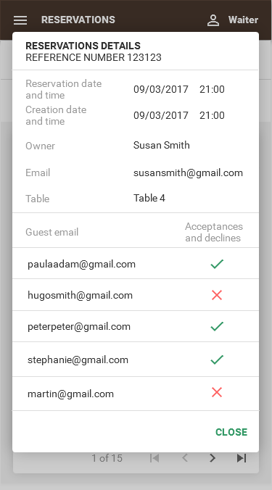
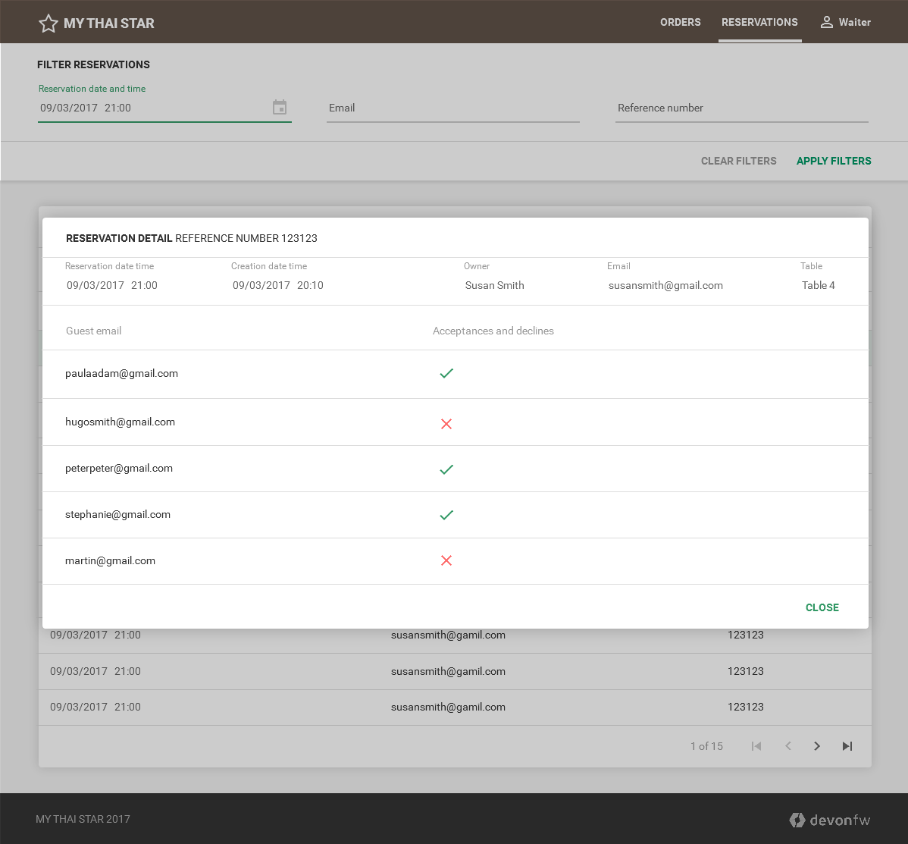
Waiter area: reservations detail
Desktop
Mobile

